Slide 1
State of the Art
Understanding the Latest Developments for Effective Robot Design

Slide 2

What is the state of the art?
Introduction
State of the art is a synthesised analysis of the knowledge that has been produced on what we want to investigate.
In short:
What are the different theoretical or methodological approaches that have been used in the field in which we are interested?

Slide 3

What is the state of the art?
Importance in Engineering
Helps to understand the different theoretical and methodological approaches to a specific topic.
Helps to identify/track the different approaches and gaps in a field of study.
Helps identify the latest advancements and best practices.
Avoids reinventing the wheel and enhances innovation.

Slide 4
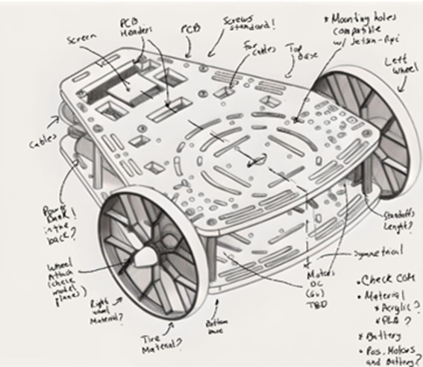
What is the state of the art?
Relevance to Robotics
Ensures robots integrate cutting-edge technologies for efficiency and effectiveness.
Robotics is a multidisciplinary field that involves AI, sensors, mechatronics, control systems, and software.
The state of the art helps engineers select the best combination of available technologies.
Avoids wasting resources on outdated methods by adopting proven technologies.
Reduces development cycles by leveraging research that has already been validated.
Identify trends in a specific robotics field.

Slide 5

State of the Art (SOTA)
Characteristics
Revolves around the topic that we want to investigate.
What is known?
What is not known?
How was it known?
What are the latest advancements?
Profound revision
Learn what to investigate and how to investigate…
“Standing on the shoulders of giants” (Isaac Newton)
Research cannot start from zero!
There is always previous research!

Slide 6
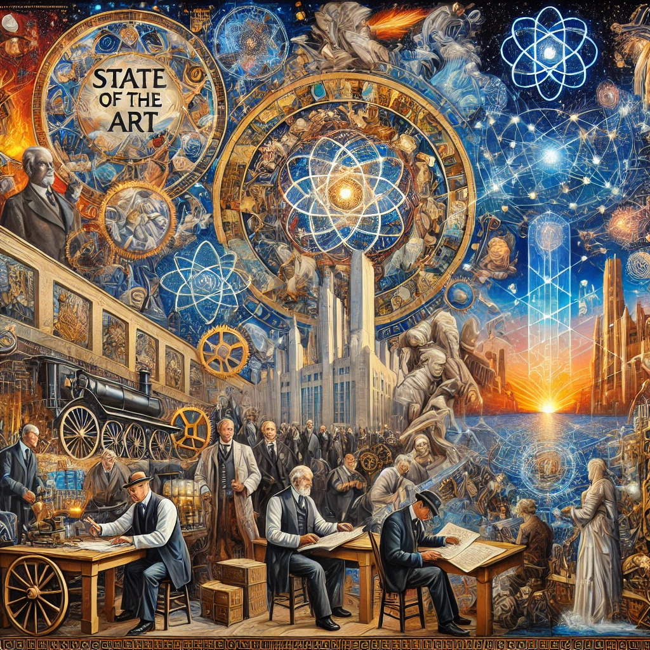
State of the Art (SOTA)
Characteristics
Acknowledge the previous research and methodologies that have been done in the field.
Why were they done?
How were they done?
Different approaches?
Successful ones, unsuccessful ones?
Useful to know how the knowledge is evolving in the field.
Estimate the different approaches on a field.
Try to estimate the new developments.

Slide 7
Making a state of the Art
1. Define the Research Topic Clearly
Define and understand the concept or research topic.
Be specific about what aspect of the topic you want to explore.
2. Identify Reliable Sources
Use academic databases (Google Scholar, IEEE Xplore, ScienceDirect, Springer).
Benchmark Existing Technologies
Look for review papers, patents, and conference proceedings.
Check industry reports.
3. Gather and Organize Key Publications
Select the most recent and highly cited papers.
Organize sources into categories (theoretical background, methodologies, applications).
4. Analyse the Evolution of the Field
Identify historical milestones (when the field started and key breakthroughs).
Compare early approaches vs. modern techniques.

Slide 8
Making a state of the Art
5. Identify Key Technologies and Trends
What sensors, AI models, or control algorithms are currently used?
Which technologies are becoming obsolete?
Identify Standards, regulations and norms used in industry/research.
6. Highlight Gaps and Challenges
What limitations still exist?
Are there unanswered research questions?
7. Summarize and Synthesize Findings
Write a structured summary (Introduction, Current Trends, Challenges, Future Directions).
Provide comparisons and insights rather than just listing papers.

Slide 9
Activity
Deliverable

Slide 10
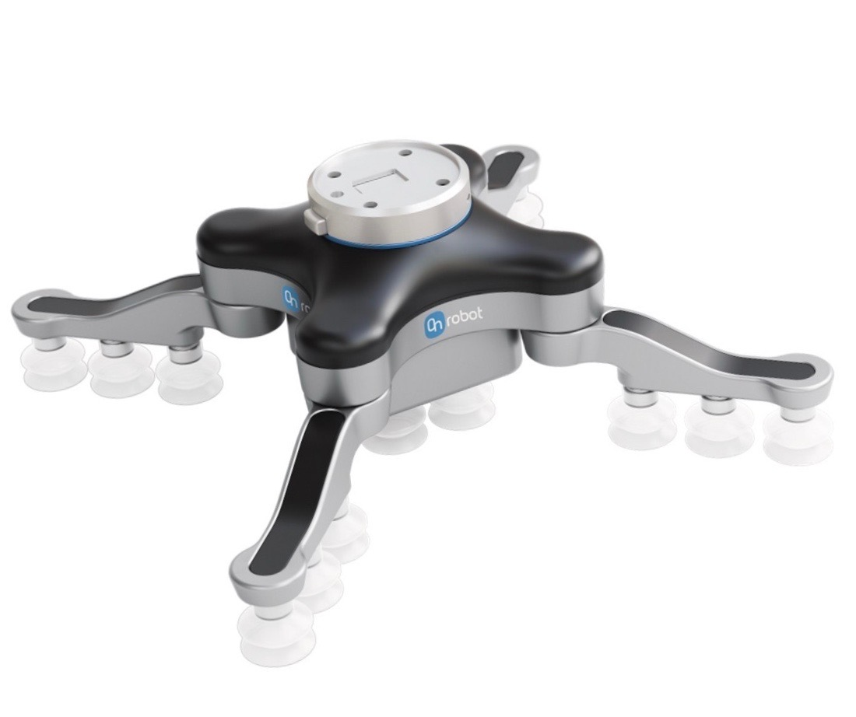
State of the Art Activity
Purpose
To analyse the current methods and technologies of robotics systems.
Instructions
Develop a state-of-the-art analysis paper (review research articles, patents, industrial developments, industrial standards/regulations and normativity, etc.) on the Gripper and Fixtures developed for the challenge.

Slide 11
State of the Art Activity
The paper should contain:
Title, Abstract, Introduction,
State of the Art:
Concept, Literature review, Key technology/methodologies, Safety Standards and Regulations (if applicable), Applications, Current challenges/open problems and Trends.
Conclusions
References (research articles/books, patents and industrial developments)
Report
Name, Student ID
4 Pages (not including title)
Arial 12, 1.5 Line spacing
Use IEEE referencing.

